Slide 1
PRINCIPAL COMPONENT ANALYSIS(PCA)

Slide 2
WHAT IS IT?
Simply stated, PCA is a technique of Dimensionality Reduction of a n-dimensional feature space.
There are many ways to achieve dimensionality reduction, most of these techniques fall short in two categories:
Feature Elimination
Feature Extraction

Slide 3
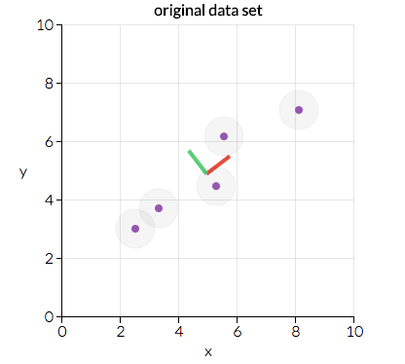
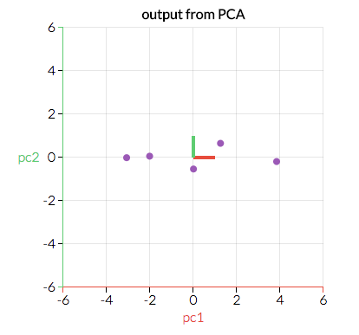
Principal component analysis is a technique for feature extraction — so it combines our input variables in a specific way, then we can drop the “least important” variables while still retaining the most valuable parts of all of the variables!

Slide 4
Mathematics Behind PCA
The whole process of obtaining principle components from a raw dataset can be simplified in six parts :
Take the whole dataset consisting of d+1 dimensions and ignore the labels such that our new dataset becomes d dimensional.
Compute the mean for every dimension of the whole dataset.
Compute the covariance matrix of the whole dataset.
Compute eigenvectors and the corresponding eigenvalues.
Sort the eigenvectors by decreasing eigenvalues and choose k eigenvectors with the largest eigenvalues to form a d × k dimensional matrix W.
Use this d × k eigenvector matrix to transform the samples onto the new subspace.

Slide 5
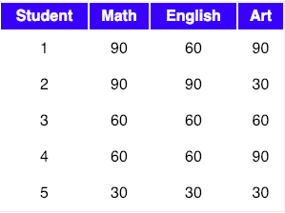
Step-1 : Take the whole dataset consisting of d+1 dimensions and ignore the labels such that our new dataset becomes d dimensional.
Let’s say we have a dataset which is d+1 dimensional. Where d could be thought as X_train and 1 could be thought as y_train (label/target) in modern machine learning paradigm. So, X_train + y_train makes up our complete train dataset.
So, after we drop the labels we are left with d dimensional dataset and this would be the dataset we will use to find the principal components. Also, let’s assume we are left with a three-dimensional dataset after ignoring the labels i.e d = 3.
we will assume that the samples stem from two different classes, where one-half samples of our dataset are labeled class 1 and the other half class 2.
Let our data matrix X be the score of these students :

Slide 6
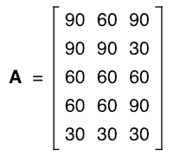

Step-2 : Compute the mean of every dimension of the whole dataset.
The data from the above table can be represented in matrix A, where each column in the matrix shows scores on a test and each row shows the score of a student.
So, The mean of matrix A would be:

Slide 7

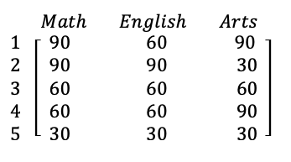
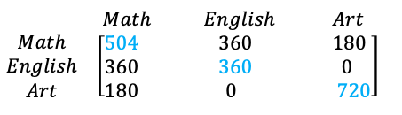
Step-3 : Compute the covariance matrix of the whole dataset
So, we can compute the covariance of two variables X and Y using the following formula:
Using the above formula, we can find the covariance matrix of A. Also, the result would be a square matrix of d ×d dimensions. Let’s rewrite our original matrix like this:
Its covariance matrix would be: AA^{T}

Slide 8
Few points that can be noted here is :
Shown in Blue along the diagonal, we see the variance of scores for each test. The art test has the biggest variance (720); and the English test, the smallest (360). So we can say that art test scores have more variability than English test scores.
The covariance is displayed in black in the off-diagonal elements of the matrix A
a) The covariance between math and English is positive (360), and the covariance between math and art is positive (180). This means the scores tend to covary in a positive way. As scores on math go up, scores on art and English also tend to go up; and vice versa.
b) The covariance between English and art, however, is zero. This means there tends to be no predictable relationship between the movement of English and art scores.

Slide 9



Step-4 : Compute Eigenvectors and corresponding Eigenvalues
Intuitively, an eigenvector is a vector whose direction remains unchanged when a linear transformation is applied to it.
Now, we can easily compute eigenvalue and eigenvectors from the covariance matrix that we have above.
Let ’A’ be a square matrix, ’ν’ a vector and ’λ’ a scalar that satisfies Aν = λν, then λ is called eigenvalue associated with eigenvector ν of A.
The eigenvalues of A are roots of the characteristic equation
Calculating det(A-λI) first, I is an identity matrix :
Simplifying the matrix first, we can calculate the determinant later,

Slide 10



Now that we have our simplified matrix, we can find the determinant of the same :
We now have the equation and we need to solve for λ, so as to get the eigenvalue of the matrix. So, equating the above equation to zero :
After solving this equation for the value of λ, we get the following values which are the eigenvalues.

Slide 11

Now, we can calculate the eigenvectors corresponding to the above eigenvalues. I am skipping how to calculate eigenvector here.
So, after solving for eigenvectors we would get the following solution for the corresponding eigenvalues:

Slide 12

Step-5 : Sort the eigenvectors by decreasing eigenvalues and choose k eigenvectors with the largest eigenvalues to form a d × k dimensional matrix W.
We started with the goal to reduce the dimensionality of our feature space, i.e., projecting the feature space via PCA onto a smaller subspace, where the eigenvectors will form the axes of this new feature subspace. However, the eigenvectors only define the directions of the new axis, since they have all the same unit length 1.
So, in order to decide which eigenvector(s) we want to drop for our lower-dimensional subspace, we have to take a look at the corresponding eigenvalues of the eigenvectors. Roughly speaking, the eigenvectors with the lowest eigenvalues bear the least information about the distribution of the data, and those are the ones we want to drop.
The common approach is to rank the eigenvectors from highest to lowest corresponding eigenvalue and choose the top k eigenvectors.
So, after sorting the eigenvalues in decreasing order, we have

Slide 13
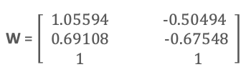
For our simple example, where we are reducing a 3-dimensional feature space to a 2-dimensional feature subspace, we are combining the two eigenvectors with the highest eigenvalues to construct our d×k dimensional eigenvector matrix W.
So, eigenvectors corresponding to two maximum eigenvalues are :

Slide 14
Step-6 : Transform the samples onto the new subspace
In the last step, we use the 2×3 dimensional matrix W that we just computed to transform our samples onto the new subspace via the equation y = W′ × x where W′ is the transpose of the matrix W.
So lastly, we have computed our two principal components and projected the data points onto the new subspace.

Slide 15
Thanks!

